Slide 1
CHAPTER 4
MEASURES OF POSITION

Slide 2
Skewness
Skewness measures the lack of symmetry in a data distribution
The value of skewness falls between – 3.0 and +3.0
The skewness value of – 3.0 indicates that the distribution is extremely skewed to the left
The skewness value of + 3.0 indicates that the distribution is extremely skewed to the right
The skewness value of 0 indicates the distribution is symmetrical
However, in research, data are considered to be normally distributed if the skewness value falls between – 1.0 to +1.0

Slide 3
a) Mean > Median > Mode : The distribution is positively skewed or is skewed to the right
Mode Median Mean
Figure 4.7 Distribution is positively

Slide 4
EXAMPLE – Exam scores
Mean = 70 marks
Median = 50 marks
Mode = 20 marks
Mode – the most occur
Exam scores
Mode=20
Median=50
Mean=70
The distribution is positively skewed or is skewed to the right

Slide 5
b) Mean = Median = Mode : The distribution is symmetrical
Mean
Median
Mode
Figure 4.8 Distribution is symmetrical

Slide 6
c) Mean < Median < Mode : The distribution is negatively skewed or is skewed to the left
Mean Median Mode
Figure 4.9 Distribution is negatively skewed

Slide 7
EXAMPLE – Exam scores
Mean = 20 marks
Median = 50 marks
Mode = 60 marks
Mode – the most occur
Exam scores
Mean=20
Median=50
Mode=60
The distribution is negatively skewed or is skewed to the left

Slide 8
MEASURES OF POSITION
(Ungrouped data)

Slide 9
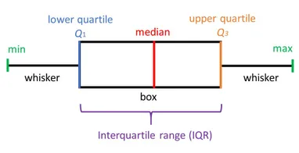
Box and Whisker Plot
A box and whisker plot provides useful graphical representation of data using the minimum value, first quartile, second quartile, third quartile and maximum value.

Slide 10

Example 1
Below represent quiz scores out of 20 points for Quiz 1
Min = 2
Q1 = 4
Q2 = 12
Q3 =15
Max = 20
2
8
3
5
2
4
12
15
20

Slide 11
Interpretation
The distribution is slightly skewed to the right
2
4
12
15
20

Slide 12
First quartiles, Q1
The first quartiles is a proportional value where 25% of the observations are smaller and 75% are larger than the value
Example 4.7 The three year annual returns of 14 low risk funds arranged in ascending order are given as follows.
9.77 | 11.35 | 12.46 | 13.80 | 15.47 | 17.48 | 18.37
18.47 | 18.61 | 20.72 | 21.49 | 22.47 | 31.50 | 38.16

Slide 13
Steps
1) Sort data in ascending order
2) Position of first quartile
3) First quartile, Q1 = 13.80
9.77 | 11.35 | 12.46 | 13.80 | 15.47 | 17.48 | 18.37
18.47 | 18.61 | 20.72 | 21.49 | 22.47 | 31.50 | 38.16

Slide 14
Third quartiles, Q3
The first quartiles is a proportional value where 75% of the observations are smaller and 25% are larger than the value
Example 4.7 The three year annual returns of 14 low risk funds arranged in ascending order are given as follows.
9.77 | 11.35 | 12.46 | 13.80 | 15.47 | 17.48 | 18.37
18.47 | 18.61 | 20.72 | 21.49 | 22.47 | 31.50 | 38.16

Slide 15
Steps
1) Sort data in ascending order
2) Position of third quartile
3) Third quartile, Q3 = 21.49
9.77 | 11.35 | 12.46 | 13.80 | 15.47 | 17.48 | 18.37
18.47 | 18.61 | 20.72 | 21.49 | 22.47 | 31.50 | 38.16

Slide 16
MEASURES OF POSITION
(Grouped data)

Slide 17
Info
 |  | Formula | Graph
Measures of position | First quartile |  | Ogive
 | Third quartile |  | Ogive

Slide 18
First quartile, Q1
For grouped data, first quartile is calculated as follows.
where
n | = sample size
L₁ | = lower boundary of the Q1 class
F₁ | = cumulative frequency before the Q1 class
f₁ | = frequency of the Q1 class
C₁ | = Q1 class size

Slide 19
First quartile, Q1
Using FORMULA

Slide 20
Example 4.12
The table shows the distribution of test scores obtained by 42 students in a Statistics class
Calculate the first quartile,Q1 and explain its meaning.
Scores obtained | Number of students
80 – 90 | 1
90 – 100 | 2
100 – 110 | 5
110 – 120 | 10
120 – 130 | 15
130 – 140 | 7
140 – 150 | 2
Total | 42

Slide 21
Step 1: Obtain the cumulative frequencies
Scores obtained | Number of employees (f) | Cumulative frequency
80 – 90 | 1 | 1
90 – 100 | 2
100 – 110 | 5
110 – 120 | 10
120 – 130 | 15
130 – 140 | 7
140 – 150 | 2
Total | 42
3
8
18
33
40
42

Slide 22
Step 2: Obtain the position of data
Scores obtained | Number of employees (f) | Cumulative frequency | Position of data
80 – 90 | 1 | 1
90 – 100 | 2 | 3
100 – 110 | 5 | 8
110 – 120 | 10 | 18
120 – 130 | 15 | 33
130 – 140 | 7 | 40
140 – 150 | 2 | 42
Total | 42
1
2 – 3
4 – 8
9 – 18
19 – 33
34 – 40
41 – 42

Slide 23
Step 3: Obtain the first quartile location
Step 4: Obtain the first quartile class
or
10.5th is between
9 and 18
Scores obtained | Number of employees (f) | Cumulative frequency | Position of data
80 – 90 | 1 | 1 | 1
90 – 100 | 2 | 3 | 2 – 3
100 – 110 | 5 | 8 | 4 – 8
110 – 120 | 10 | 18 | 9 – 18
120 – 130 | 15 | 33 | 19 – 33
130 – 140 | 7 | 40 | 34 – 40
140 – 150 | 2 | 42 | 41 – 42
Total | 42
Q1
class

Slide 24
Step 5: Apply the formula
Interpretation
25% of students scored less than 112.5 marks and other 75% scored more than 112.5 marks

Slide 25
First quartile, Q1
Using OGIVE

Slide 26
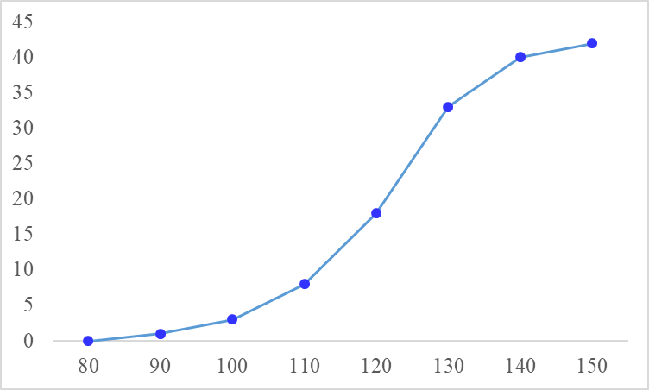
Estimating the Q1 from an OGIVE
The distribution of test scores obtained
by 42 students in a Statistics class
No. of students
Q1 position= 10.5th
Scores
Q1 value = 112.5

Slide 27
Third quartile, Q3
For grouped data, third quartile is calculated as follows.
where
n | = sample size
L₃ | = lower boundaries of the Q3 class
F₃ | = cumulative frequency before the Q3 class
f₃ | = frequency of the Q3 class
C₃ | = Q3 class size

Slide 28
Third quartile, Q3
Using FORMULA

Slide 29
Example 4.12
The table shows the distribution of test scores obtained by 42 students in a Statistics class
Calculate the third quartile,Q3 and explain its meaning.
Scores obtained | Number of students
80 – 90 | 1
90 – 100 | 2
100 – 110 | 5
110 – 120 | 10
120 – 130 | 15
130 – 140 | 7
140 – 150 | 2
Total | 42

Slide 30
Step 1: Obtain the cumulative frequencies
Scores obtained | Number of employees (f) | Cumulative frequency
80 – 90 | 1 | 1
90 – 100 | 2
100 – 110 | 5
110 – 120 | 10
120 – 130 | 15
130 – 140 | 7
140 – 150 | 2
Total | 42
3
8
18
33
40
42

Slide 31
Step 2: Obtain the position of data
Scores obtained | Number of employees (f) | Cumulative frequency | Position of data
80 – 90 | 1 | 1
90 – 100 | 2 | 3
100 – 110 | 5 | 8
110 – 120 | 10 | 18
120 – 130 | 15 | 33
130 – 140 | 7 | 40
140 – 150 | 2 | 42
Total | 42
1
2 – 3
4 – 8
9 – 18
19 – 33
34 – 40
41 – 42

Slide 32
Step 3: Obtain the third quartile location
Step 4: Obtain the third quartile class
or
31.5th is between
19 and 33
Scores obtained | Number of employees (f) | Cumulative frequency | Position of data
80 – 90 | 1 | 1 | 1
90 – 100 | 2 | 3 | 2 – 3
100 – 110 | 5 | 8 | 4 – 8
110 – 120 | 10 | 18 | 9 – 18
120 – 130 | 15 | 33 | 19 – 33
130 – 140 | 7 | 40 | 34 – 40
140 – 150 | 2 | 42 | 41 – 42
Total | 42
Q3
class

Slide 33
Step 5: Apply the formula
Interpretation
75% of students scored less than 129 marks and other 25% scored more than 129 marks

Slide 34
Third quartile, Q3
Using OGIVE

Slide 35
Estimating the Q3 from an OGIVE
The distribution of test scores obtained
by 42 students in a Statistics class
No. of students
Q3 position= 31.5th
Scores
Q3 value = 129

Slide 36
END

